Slide 1
iSurvive
Find people. Not zombies.
TEAM STRAIGHT-THROUGH-THE-BRAINS
Photo by Tony Moore Illustration¹

Slide 2
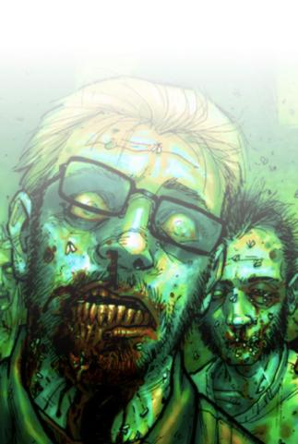
INTRODUCTION
PREDISPOSITIONS
RESEARCH
INSIGHTS
CONCEPTS
PROTOTYPES
STRATEGIES
The problem
Notes:
Problem:
Post-apocalypse people need to find other people and California while avoiding zombie contact.

Slide 3
INTRODUCTION
PREDISPOSITIONS
RESEARCH
INSIGHTS
CONCEPTS
PROTOTYPES
STRATEGIES
The problem
The mission
Notes:
Core:
Help survivors find each other and avoid zombies by providing directions with minimal interruptions.

Slide 4
Loners want company.
INTRODUCTION
PREDISPOSITIONS
RESEARCH
INSIGHTS
CONCEPTS
PROTOTYPES
STRATEGIES
Notes:
Many people are traveling alone and would like to have a group of people to travel with. Additionally, some groups are looking for more members.

Slide 5
Loners want company.
Phones can send, receive, and cache information.
INTRODUCTION
PREDISPOSITIONS
RESEARCH
INSIGHTS
CONCEPTS
PROTOTYPES
STRATEGIES
Notes:
Even though phones are unable to make phone calls, text, or get on the Internet, GPS technology is advanced enough to send information (apps, announcements, location, etc.). Phones are also able to push information out when they are in areas that have a GPSO signal. Additionally, phones may not always have a strong GPS signal, but they automatically cache the information that was available to them at the last time they had a strong signal.

Slide 6
Loners want company.
Phones can send, receive, and cache information.
California-bound, avoiding zombies.
INTRODUCTION
PREDISPOSITIONS
RESEARCH
INSIGHTS
CONCEPTS
PROTOTYPES
STRATEGIES
Notes:
Most people have heard the rumor that the government is rebuilding in California, so they are traveling towards California. They want to take the most direct route, but are willing to re-route if it means staying away from zombies.
OTHER PREDISPOSITIONS:
Most people don’t know how to survive in “the wild”.
Most people have smart phones and can use them.
Because of solar-powered batteries, we don’t need to worry about the phones losing battery life.
GPS signal isn’t always reliable, but we are able to display where the low-signal areas are.

Slide 7
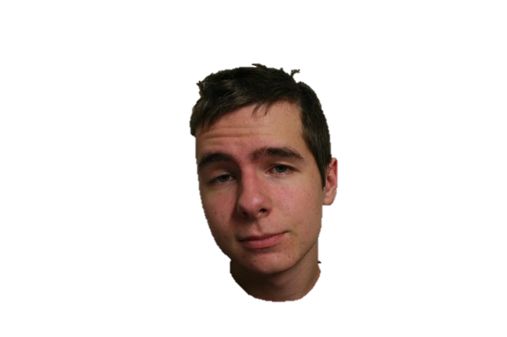
Joseph Bartlow
ZOMBIE EXPERT
INTRODUCTION
PREDISPOSITIONS
RESEARCH
INSIGHTS
CONCEPTS
PROTOTYPES
STRATEGIES
Notes:
Interviewed with a zombie expert: Joe Bartlow
CREDENTIALS
Has read zombie survival guide 5 times
8 zombie movies (owns and rewatches)
Has read world war z
Zombie video games
Watched walking dead series
HOW TO IDENTIFY A ZOMBIE
Missing appendages
Rotting
People turning into zombies
Bite mark
Fever / bad flu symptoms
Could “hide” an infection for around 12 hours
Corpse can still infect someone
Can “pretend” to be dead (hard to tell if actually dead or just lying there)
ABOUT ZOMBIES
They have no fear (not even of fire)
Intelligence: 0 motor skills
Probably can’t read or recognize symbols
Not so good at opening doors, etc.
HOW TO KILL ZOMBIES
Destroy the brain
Bullets
Stab
General damage to brain
Bow and arrows (or crossbow) are best
HOW NOT TO KILL ZOMBIES
Fire is bad. Leads to flaming zombies.
BENEFITS OF GROUPS OF PEOPLE
First aid training
Survival skills
Repair (carpenter / mechanic)
Fixing stuff would be nice.
Group size
Too large makes it hard to get around zombies, but there is safety in numbers. Large groups can lead to panic.
TRANSPORTATION Cars will really only last a year. After that, no access to gas that is usable (octane all evaporated) .
JOE’S SURVIVAL PLAN
go to a motor pool, steal a humvee (enclosed storage) loot for supplies water, crowbar, food (canned stuff is best) head to parent’s property, pick up people on the way if encounters a zombie: run away. Hand to hand isn’t really an option. Must have a contingency plan California might not be the best, need a plan b. Go somewhere cold! Zombies freeze.

Slide 8
Joseph Bartlow
ZOMBIE EXPERT
INTRODUCTION
PREDISPOSITIONS
RESEARCH
INSIGHTS
CONCEPTS
PROTOTYPES
STRATEGIES
Zombies lack motor skills and intelligence.
Notes:
Interviewed with a zombie expert: Joe Bartlow
CREDENTIALS
Has read zombie survival guide 5 times
8 zombie movies (owns and rewatches)
Has read world war z
Zombie video games
Watched walking dead series
HOW TO IDENTIFY A ZOMBIE
Missing appendages
Rotting
People turning into zombies
Bite mark
Fever / bad flu symptoms
Could “hide” an infection for around 12 hours
Corpse can still infect someone
Can “pretend” to be dead (hard to tell if actually dead or just lying there)
ABOUT ZOMBIES
They have no fear (not even of fire)
Intelligence: 0 motor skills
Probably can’t read or recognize symbols
Not so good at opening doors, etc.
HOW TO KILL ZOMBIES
Destroy the brain
Bullets
Stab
General damage to brain
Bow and arrows (or crossbow) are best
HOW NOT TO KILL ZOMBIES
Fire is bad. Leads to flaming zombies.
BENEFITS OF GROUPS OF PEOPLE
First aid training
Survival skills
Repair (carpenter / mechanic)
Fixing stuff would be nice.
Group size
Too large makes it hard to get around zombies, but there is safety in numbers. Large groups can lead to panic.
TRANSPORTATION Cars will really only last a year. After that, no access to gas that is usable (octane all evaporated) .
JOE’S SURVIVAL PLAN
go to a motor pool, steal a humvee (enclosed storage) loot for supplies water, crowbar, food (canned stuff is best) head to parent’s property, pick up people on the way if encounters a zombie: run away. Hand to hand isn’t really an option. Must have a contingency plan California might not be the best, need a plan b. Go somewhere cold! Zombies freeze.

Slide 9
Joseph Bartlow
ZOMBIE EXPERT
INTRODUCTION
PREDISPOSITIONS
RESEARCH
INSIGHTS
CONCEPTS
PROTOTYPES
STRATEGIES
Groups provide benefits.
Notes:
Interviewed with a zombie expert: Joe Bartlow
CREDENTIALS
Has read zombie survival guide 5 times
8 zombie movies (owns and rewatches)
Has read world war z
Zombie video games
Watched walking dead series
HOW TO IDENTIFY A ZOMBIE
Missing appendages
Rotting
People turning into zombies
Bite mark
Fever / bad flu symptoms
Could “hide” an infection for around 12 hours
Corpse can still infect someone
Can “pretend” to be dead (hard to tell if actually dead or just lying there)
ABOUT ZOMBIES
They have no fear (not even of fire)
Intelligence: 0 motor skills
Probably can’t read or recognize symbols
Not so good at opening doors, etc.
HOW TO KILL ZOMBIES
Destroy the brain
Bullets
Stab
General damage to brain
Bow and arrows (or crossbow) are best
HOW NOT TO KILL ZOMBIES
Fire is bad. Leads to flaming zombies.
BENEFITS OF GROUPS OF PEOPLE
First aid training
Survival skills
Repair (carpenter / mechanic)
Fixing stuff would be nice.
Group size
Too large makes it hard to get around zombies, but there is safety in numbers. Large groups can lead to panic.
TRANSPORTATION Cars will really only last a year. After that, no access to gas that is usable (octane all evaporated) .
JOE’S SURVIVAL PLAN
go to a motor pool, steal a humvee (enclosed storage) loot for supplies water, crowbar, food (canned stuff is best) head to parent’s property, pick up people on the way if encounters a zombie: run away. Hand to hand isn’t really an option. Must have a contingency plan California might not be the best, need a plan b. Go somewhere cold! Zombies freeze.

Slide 10
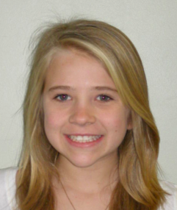
INTRODUCTION
PREDISPOSITIONS
RESEARCH
INSIGHTS
CONCEPTS
PROTOTYPES
STRATEGIES
Personas
LARRY the LEADER
OLIVIA the ORPHAN
Photos by Ivan Walsh² and Triad Idol³
Notes:
Larry the Leader
Key Distinguishing Feature: Is a natural, altruistic, reluctant leader
Descriptive Dimensions:
Knowledge
Weapons expert
Some survival techniques
Leadership
Tasks
Keep the peace
Caring for his children
Training the others
Interests
Survival
Finding loners
Keeping people safe
Characteristics
Altruistic
Loyal
Motivated
Stoic
Objectives & Motivations: Keep everyone together and safe
Survive
Find shelter, food, water, supplies Get to California
Source: Based on Rick Grimes from The Walking Dead Concerns: Am I doing a good job leading the others? Is everyone safe? Even if I protect people from zombies, how do I keep them alive? He has a general idea of what direction to go in, but is unsure of the landscape ahead of him.
Scenario Awoke in a hospital after the infection had already spread. Eventually found his way to his family and was appointed the “leader” of the group due to his previous occupation as a Sheriff’s deputy. So far he has been able to find firearms, food, and water, but these supplies have become scarce as they get closer to California. His group has picked up members along the way, but has also lost a few to zombies. Background
Sheriff’s deputy from Georgia.
Family
2 children
Wife
Olivia the Orphan
Key Distinguishing Feature:All alone after the zombies ate her parents.
Descriptive dimensions:
Knowledge
Little to none
Can navigate through a smart phone (or whatever)
Tasks
Find other people
Find food and water
Avoid zombies
Interests
Survival
Finding adults
Keeping safe
Characteristics
12 years old
Scared (which makes her “jumpy”)
Motivated to find others
Objectives & Motivations:
Find other people, especially trustworthy adults
Survive
Find shelter, food, water, supplies
Avoid zombies
Source:
Based on Little Rock from Zombieland Concerns:
Where is everyone?
Am I going to make it through the night?
How will I find food tomorrow?
How do I kill zombies?
Scenarios Olivia came home from school one day to find her parents feverish and in the yard. She sat with them until she became concerned enough to call 911. The emergency dispatch told her the situation and that they would not be able to reach her. She has been trying to find a non-zombie adult ever since.

Slide 11
Help survival with minimal interaction.
INTRODUCTION
PREDISPOSITIONS
RESEARCH
INSIGHTS
CONCEPTS
PROTOTYPES
STRATEGIES
Notes:
Our interface should help increase a person’s chance of survival, but shouldn’t detract from their ability to stay attentive and defend themselves and others from zombies.

Slide 12
Help survival with minimal interaction.
Provide important survival information for “down time”.
INTRODUCTION
PREDISPOSITIONS
RESEARCH
INSIGHTS
CONCEPTS
PROTOTYPES
STRATEGIES
Notes:
When people aren’t in immediate danger (e.g., running from zombies), they should be able to browse information that may help them survive during their journey (first aid, identifying and killing zombies, getting food and water, building shelter, etc.).

Slide 13
Help survival with minimal interaction.
Provide important survival information for “down time”.
Continue functionality with no GPS signal.
INTRODUCTION
PREDISPOSITIONS
RESEARCH
INSIGHTS
CONCEPTS
PROTOTYPES
STRATEGIES
Notes:
If people are in a location with no or low GPS signal, they should still be able to benefit from the app. The app should cache information it last received when it was within GPS range, and the information should remain available until new information is pushed to the phone.

Slide 14
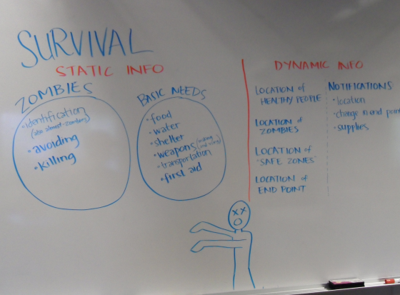
INTRODUCTION
PREDISPOSITIONS
RESEARCH
INSIGHTS
CONCEPTS
PROTOTYPES
STRATEGIES
Notes:
Before sketching any concepts, we wrote out all of the information, both static and dynamic, that may help somebody survive during a zombie apocalypse. It became obvious pretty quickly that we would not be able to address all areas of information in our design.

Slide 15
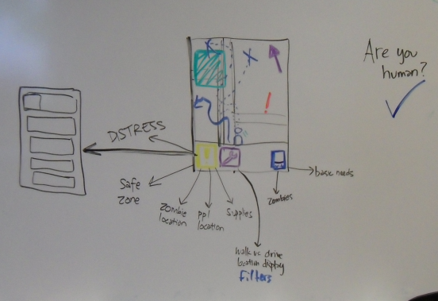
INTRODUCTION
PREDISPOSITIONS
RESEARCH
INSIGHTS
CONCEPTS
PROTOTYPES
STRATEGIES
Notes:
We started sketching, and came up with a few interfaces that had a lot of information on each screen.

Slide 16
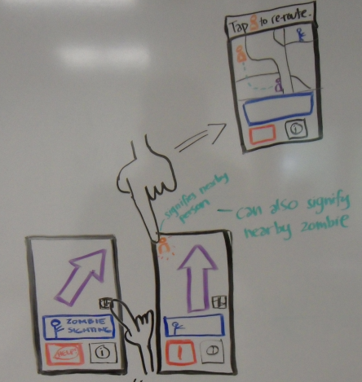
INTRODUCTION
PREDISPOSITIONS
RESEARCH
INSIGHTS
CONCEPTS
PROTOTYPES
STRATEGIES
Notes:
We came up with various ideas, each focusing on a different main task. We tried to make our concepts simple and easy.

Slide 17
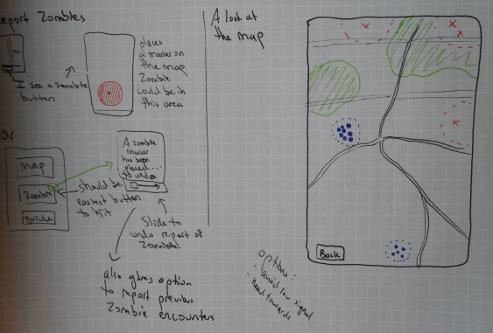
INTRODUCTION
PREDISPOSITIONS
RESEARCH
INSIGHTS
CONCEPTS
PROTOTYPES
STRATEGIES
Notes:
Initially we leaned towards putting the priority on finding and reporting zombies, but we found a lot of flaws with that goal.

Slide 18
INTRODUCTION
PREDISPOSITIONS
RESEARCH
INSIGHTS
CONCEPTS
PROTOTYPES
STRATEGIES
iSurvive
The ultimate post-apocalypse buddy system.
Notes:
Our final concept: iSurvive. The goal is to help people find other people while still heading towards California and avoiding zombies.

Slide 19
INTRODUCTION
PREDISPOSITIONS
RESEARCH
INSIGHTS
CONCEPTS
PROTOTYPES
STRATEGIES
Are you a human?
EMERGENCY
Notes:
Olivia opens up her phone to see where she is on the map and where she should go. First she has to prove that she’s a human.
We do the human test so that when people appear on maps, you can see the last time they proved they were human by turning on “Show paths” in the map settings menu. People will be prompted every 2 hours to prove that they’re human. If somebody has gone a long time without proving their human, the phone can be used as a zombie tracker.

Slide 20
Are you a human?
EMERGENCY
Notes:
Human animation

Slide 21
Map
Guide
Groups
Report zombie activity
EMERGENCY
Notes:
Next Olivia gets to the main menu. She clicks on Maps.

Slide 22
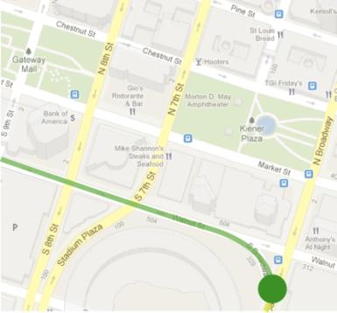
Settings
EMERGENCY
Notes:
Olivia sees where she is on the map. Suddenly, she gets an alert.

Slide 23
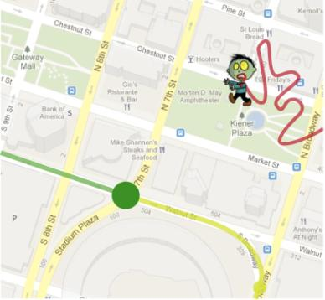
Settings
POSSIBLE ZOMBIE ENCOUNTER.
Reroute?
Yes
No
EMERGENCY
Notes:
Olivia’s phone alerted her that there will be a possible zombie encounter and asks if she wants to reroute. She chooses yes.

Slide 24
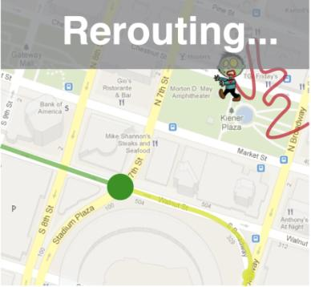
Settings
EMERGENCY
Notes:
Rerouting screen

Slide 25
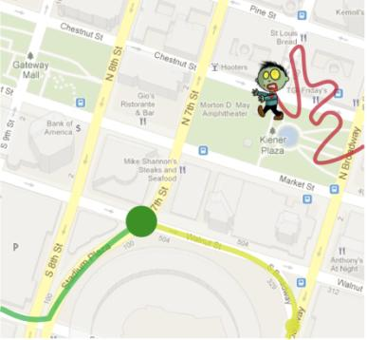
Settings
EMERGENCY
Notes:
Olivia sees on the map that she has a new path that is avoiding the possible zombie.

Slide 26
Settings
There is a group of 5 people nearby:
LEADER: Larry the Leader
NOTES: We have some weapons and supplies, but need to find more soon. Some first aid experience.
View group location
Meet
Ignore
EMERGENCY
Notes:
Olivia sees a notification that there is a nearby group, lead by Larry the Leader. She can either request to meet them or ignore them. She chooses to first view their location.

Slide 27
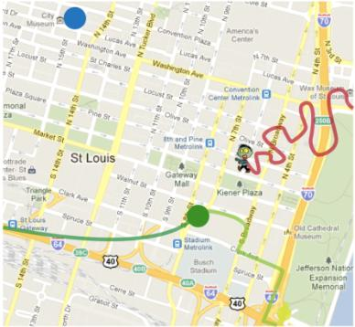
Settings
Meet
Ignore
EMERGENCY
Notes:
Olivia sees that the group is not very far away. She’s incredibly relieved to see another group, so she chooses to meet them. She goes where the map directs her, and she finally meets up with Larry’s group. Larry tells her that she should use the iSurvive app to officially join their group. This will work through the phone’s bluetooth technology.

Slide 28
Settings
Sending request to meet…
EMERGENCY
Notes:
The meet-up request is sent…

Slide 29
Settings
Meet-up confirmed!
View new route
EMERGENCY
Notes:
On the other end, Larry seems to have confirmed the meet-up. Olivia looks at the new route.

Slide 30
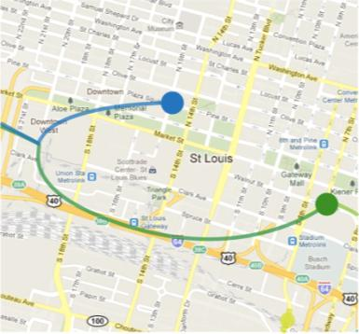
Settings
Accept new route
Propose new meet-up point
EMERGENCY
Notes:
She goes where the map directs her, and she finally meets up with Larry’s group. Larry tells her that she should use the iSurvive app to officially join their group. This will work through the phone’s bluetooth technology.

Slide 31
Are you a human?
EMERGENCY
Notes:
First Olivia has to prove that she’s a human.

Slide 32
Are you a human?
EMERGENCY
Notes:
Human test slide

Slide 33
Map
Guide
Groups
Report zombie activity
EMERGENCY
Notes:
First Olivia comes to the main menu, and she chooses “Groups”.

Slide 34
Form a group
Join a group
Leave a group
EMERGENCY
Notes:
Next she chooses “Join group”

Slide 35
Scanning for groups…
EMERGENCY
Notes:
The phone scans for nearby groups using bluetooth.

Slide 36
Group found!
LEADER: Larry the Leader
NOTES: We have some weapons and supplies, but need to find more soon. Some first aid experience
Join
Cancel
EMERGENCY
Notes:
Larry’s group is found. She chooses to join.

Slide 37
Sending request to join group…
EMERGENCY
Notes:
Olivia’s phone sends a request to Larry’s phone to join his group.

Slide 38
Success!
You are now a member of a new group.
View map
EMERGENCY
Notes:
Larry confirms her request, and she successfully joins. She then views a map of their new route.

Slide 39
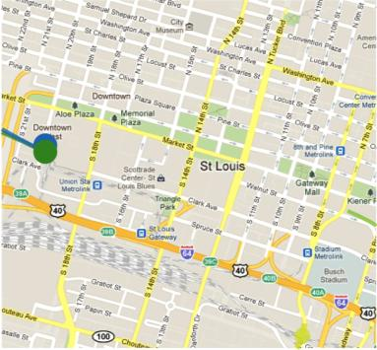
Settings
EMERGENCY
Notes:
Here is the map of their new route.

Slide 40
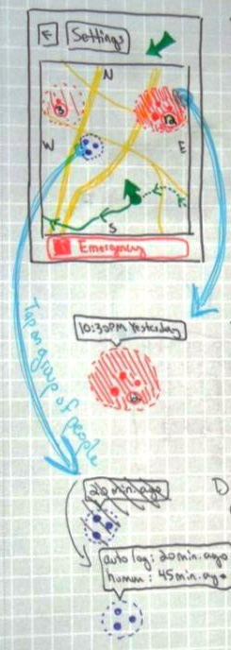
INTRODUCTION
PREDISPOSITIONS
RESEARCH
INSIGHTS
CONCEPTS
PROTOTYPES
STRATEGIES
Notes:
After user testing, there are a few features we’d add in future iterations. First, when people and zombies appear on maps, there should be more information associated with them (number of people/zombies in a group, what time they were last tracked, etc.)

Slide 41
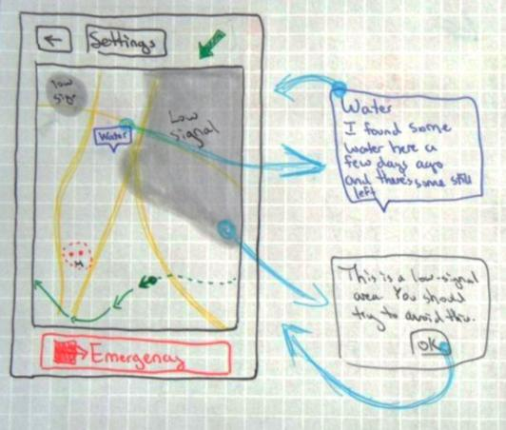
INTRODUCTION
PREDISPOSITIONS
RESEARCH
INSIGHTS
CONCEPTS
PROTOTYPES
STRATEGIES
Notes:
Our users also really liked the idea of being able to view low signal areas and view and leave notes. Here is a sketch of what these things may look like. The red color of our low signal areas in our original sketches and prototypes was a bit confusing, so we changed it to gray, which often signifies something that isn’t available.

Slide 42
BUSINESS
Survival information available
INTRODUCTION
PREDISPOSITIONS
RESEARCH
INSIGHTS
CONCEPTS
PROTOTYPES
STRATEGIES
Notes:
In addition to the map, location, and people-finding functions, our app also has a lot of built-in information (first aid, finding food and water, building and securing shelter, identifying and killing zombies, etc.) Use of iSurvive never trumps the need to run from zombies, but it has a lot of life-saving features for use when a person is not in immediate danger.

Slide 43
TECHNOLOGICAL
Connect through Bluetooth
INTRODUCTION
PREDISPOSITIONS
RESEARCH
INSIGHTS
CONCEPTS
PROTOTYPES
STRATEGIES
Notes:
The heart of our design is in connecting people with each other. Once people join in a group via Bluetooth, their phones are all connected. This could lead to more group features. For example, if people from the group get separated, the GPS could lead them back to each other.

Slide 44
TECHNOLOGICAL
Route based on signal
INTRODUCTION
PREDISPOSITIONS
RESEARCH
INSIGHTS
CONCEPTS
PROTOTYPES
STRATEGIES
Notes:
Some people might want as direct a route as possible, and aren’t worried about always having a GPS signal. Others may feel most comfortable knowing that they’ll always have a GPS signal. Perhaps the navigation could be advanced enough to let people toggle between routes that are either direct or high-signal.

Slide 45
SOCIAL
Benefits of groups
INTRODUCTION
PREDISPOSITIONS
RESEARCH
INSIGHTS
CONCEPTS
PROTOTYPES
STRATEGIES
Notes:
Our zombie expert explained many of the benefits of traveling in a group with other people. Everybody can benefit from diverse backgrounds, knowledge, and skills. However, if people would rather travel alone, or if groups do not want to add any more members, they have the option to be invisible and/or deny meet-up requests.

Slide 46
Thank you.
Stay safe. Stay together.

Slide 47
INTRODUCTION
PREDISPOSITIONS
RESEARCH
INSIGHTS
CONCEPTS
PROTOTYPES
STRATEGIES
EXTRAS
Are you a human?
EMERGENCY
Notes:
Home screen: Slide the emergency button to report an emergency.

Slide 48
INTRODUCTION
PREDISPOSITIONS
RESEARCH
INSIGHTS
CONCEPTS
PROTOTYPES
STRATEGIES
EXTRAS
Are you a human?
EMERGENCY
Notes:
The emergency button slides.

Slide 49
INTRODUCTION
PREDISPOSITIONS
RESEARCH
INSIGHTS
CONCEPTS
PROTOTYPES
STRATEGIES
EXTRAS
Your help request has been successfully reported.
When your icon appears on other people’s maps, it will have a help symbol next to it.
OK
Undo
Notes:
An emergency is successfully reported if someone is within GPS range.

Slide 50
INTRODUCTION
PREDISPOSITIONS
RESEARCH
INSIGHTS
CONCEPTS
PROTOTYPES
STRATEGIES
EXTRAS
Your help request was not reported.
Your GPS signal strength is too weak to push out a help request. The request will send when you enter an area with a stronger GPS signal.
View map with signal areas
OK
Undo
Notes:
An emergency is not successfully reported if they’re not within GPS range.

Slide 51
INTRODUCTION
PREDISPOSITIONS
RESEARCH
INSIGHTS
CONCEPTS
PROTOTYPES
STRATEGIES
EXTRAS
Settings
Show paths.
Show low signal areas.
Show notes.
Visibility settings
Walk
Drive
EMERGENCY
Notes:
Here are all of the map settings.

Slide 52
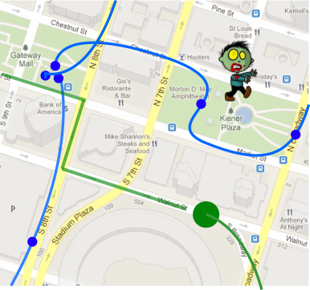
INTRODUCTION
PREDISPOSITIONS
RESEARCH
INSIGHTS
CONCEPTS
PROTOTYPES
STRATEGIES
EXTRAS
Settings
EMERGENCY
Notes:
This is what the map might look like if you turned on “Show paths”

Slide 53
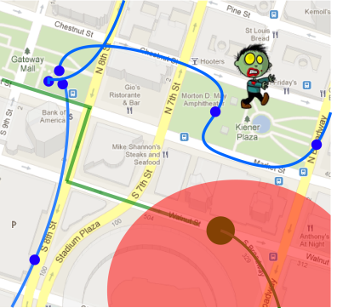
INTRODUCTION
PREDISPOSITIONS
RESEARCH
INSIGHTS
CONCEPTS
PROTOTYPES
STRATEGIES
EXTRAS
Settings
EMERGENCY
Notes:
This is what the map might look like if you chose to display low signal areas.

Slide 54
INTRODUCTION
PREDISPOSITIONS
RESEARCH
INSIGHTS
CONCEPTS
PROTOTYPES
STRATEGIES
EXTRAS
First aid
Food and water
Shelter
Zombies
Weapons
EMERGENCY
Notes:
Here are the categories within our guide.

Slide 55
USABILITY TESTING
2 participants
6 scenarios
(see comments for details)
INTRODUCTION
PREDISPOSITIONS
RESEARCH
INSIGHTS
CONCEPTS
PROTOTYPES
STRATEGIES
EXTRAS
Notes:
Prototype testing
The following scenarios were included in our PowerPoint prototype: Scenario 1
You are on your way to California. It’s been a while since you made sure you were headed the right way. What do you do? In this scenario we are hoping to see the participant we would like for the participant to perform the human test and look at the map To check that they are still headed in the right direction. Scenario 2
Your phone vibrates frantically in your pocket. What do you do? In this scenario we will introduce the participant to the zombies! Their phone is warning them of a possible zombie encounter if they continue on their current route. The phone asks them if they’d like to consider another route. Scenario 3
Your phone tells you that you have come within range of another group of people. What do you do? In this scenario, the participant walks through the steps it would take to meet up with the other group of individuals. If they decide to NOT meet the other group, allow that to play out for a bit, and then ask the participant what they would do if they DID want to meet up with that group. … You finally meet up with the other group of people and their “leader” asks you to officially join their group through the application. I’m beginning to wonder why we insist on having the group functionality at all. What benefit to the post-apocalypse users get out of being in a group? --Anna cleared it up: groups are good for keeping track of the others in your group (when they get separated, or in case they turn to zombies). Scenario 4
You just fell down some stairs and you’ve hurt your ankle pretty badly. You can still walk, but not very well. What do you do? This scenario walks the participant through emergency reporting. … Let’s try this a different way. Suppose you were in that accident but you were NOT in a good-signal area. What do you do? What do they do when there is no signal where they are? Scenario 5
You come across a couple of zombies. They didn’t notice you and you were able to maneuver your way out of there. Report the zombie activity that you spotted so that others will be aware. The scenario takes the participant through zombie reporting. Scenario 6
What other situations do you think you could run into in this zombie apocalypse? Try to play out what you would do with this prototype. Just want them to explore. Testing results
The emergency slider was not clear. One participant forgot about it completely, because it was on every screen.
It isn’t clear that our app automatically routes in a way to avoid zombies
We forgot to include time stamps in the prototype, even though it was in the design. One participant said he wished it showed the time stamp! So it was probably a good idea.
Change the compass thing
Both participants were able to understand the application and it’s purpose pretty well, but there were some confusing points. In one scenario, the participant was told that he had broken his ankle. Instead of sliding the emergency slider like we thought he would, he went to the guide and found the first aid tip that would help him fix it himself. Not a bad thing but a reminder that everyone solves problems differently. It was not clear that the app automatically routed around the zombies. Both participants wanted to be able to search for supplies and to be able to leave notes. Both participants wanted to be able to specify the type of emergency.

Slide 56
WORKING THROUGH LENSES
(see comments for details)
INTRODUCTION
PREDISPOSITIONS
RESEARCH
INSIGHTS
CONCEPTS
PROTOTYPES
STRATEGIES
EXTRAS
Notes:
We made a list of everything survivors may want and need, as well as all of the different information that might be available to them. We then discussed how we might want to prioritize these needs and the information.
We conducted an extensive interview with a zombie expert, which gave us further insights into people’s behavior during the zombie apocalypse, as well as their needs. This lead us to our personas– a leader and a helpless loner.
We came up with a lot of sketches, and explored different tasks and areas of focus. What’s more important – avoiding zombies or finding other people? How do we track zombies if they’re on the move? How do we make our app useful during times when there is no signal?
There were a lot of problems with figuring out how to identify, track, and report zombies. While this task is briefly mentioned in our final design, through our research, concepts, and insights, we agreed that it was most important and valuable to help people find and travel with other people. We continued to sketch a final concept and storyboard.
This app relies a lot on phones being able to connect to the GPS signal. How would it be useful in areas of no signal? What if people have bad intentions and want to harm or steal from other people? What if people lie about being alone and are actually in a group of people and want to attack another group? These are all potential problems, but in such a dire situation, there have to be trade-offs. We thought of Olivia, and other somewhat helpless loners, as well as people like Larry, who have some valuable leadership skills and may be able to help others survive. This app is to help these people find each other.
We started on a prototype, and continued to sketch and iterate during construction of the prorotype.
We finalized our prototype and created a scenario with Larry and Olivia, as well as 6 different scenarios for our usability tests. Our prototype really exemplified the goal of our design– bring people together.
We created a final presentation, following the PRInCiPleS framework, highlighting our process and findings.

Slide 57
Image resources
http://media.photobucket.com/image/running%20from%20zombies/sodfactor/zombies.jpg?t=1240595760
http://farm5.static.flickr.com/4064/4489008658_5a478cdb0f_z.jpg
http://triadidol.org/archives/2008.php

